Slide 1
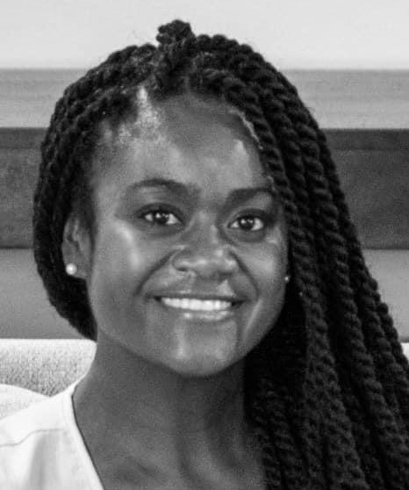
Mrs. Kathryn Hall
Welcome to 3rd Grade!
About Me
I am looking forward to having your child as a student, this year. Third grade is such a fun year with so many wonderful learning opportunities. My most important goal is create a safe and encouraging environment, where students believe they can be anything or anyone they want to be. Parents, you know your child better than anyone. Please help me achieve this goal by communicating with me and letting me know how I can support your child and your family. We will get through this year together. Please reach out to me with any questions or concerns.
Hello! I am Mrs. Hall and I am your child’s 3rd grade teacher. I have a Bachelor’s Degree in
Elementary Education and a minor in English from Webster University. This is my sixth year at Gateway. I am currently a student pursuing a Master’s Degree in School Counseling.
Contact Me
My Favorites
I welcome and value parent involvement throughout the year. I would love to hear from you. Please contact me with any questions, comments, or concerns you may have.
Food:
Tacos
Drink: Water
Candy: Kit-Kat
*314-441-6546 (cell)
Class DOJO
Hobby: Anything Outdoors
Kathryn.Hayden@slps.org
Book: “Hair Love”
Subject:
Science

